Slide 1

موقع هدايا

Slide 2

פרויקט גמר מגיש: נזאר מערוף
Bootcump full stack developer

Slide 3
موقع هدايا
אתר מתנות המספק לכם את העונג בעיצוב מתנות ייחודיות לאהוביכם, חבריכם, וכל מי שיקר לכם. אתה רק צריך להוסיף את התמונה שלך או משפט על המוצר המועדף עליך והמוצר בדרך אליך. אתר המתנות קל לשימוש וכולל רקעים ומשפטים מוכנים בנושאים שונים שמשאירים השפעה יפה. אנו עומדים לשירותכם בכל התייעצות לעיצובי VIP מיוחדים ומתנות קבוצתיות.

Slide 4
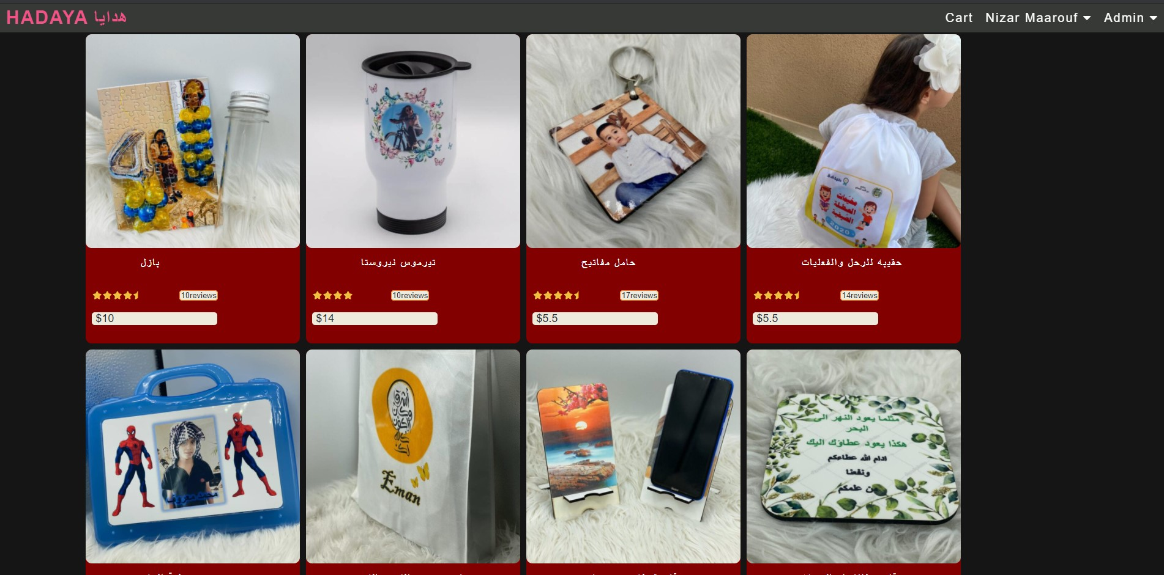
I am using all this Techniques and libraries and packages
- HTML5 and CSS3: Semantic Elements, CSS Grid, Flex box.
- React: Components, Props, Events, Hooks, Router, Axios.
- Redux: Store, Reducers, Actions.
- Node & Express: Web API, Body Parser, File Upload, JWT.
- MongoDB: Mongoose, Aggregation.
- Development: ESLint,Babel,Git , Github .
- Deployment: Heroku.

Slide 5
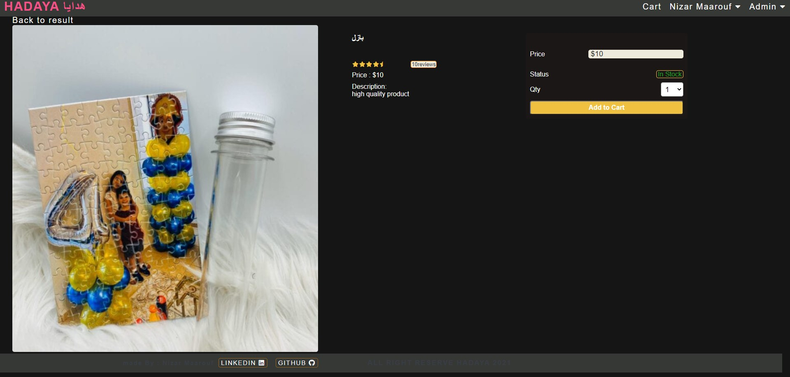
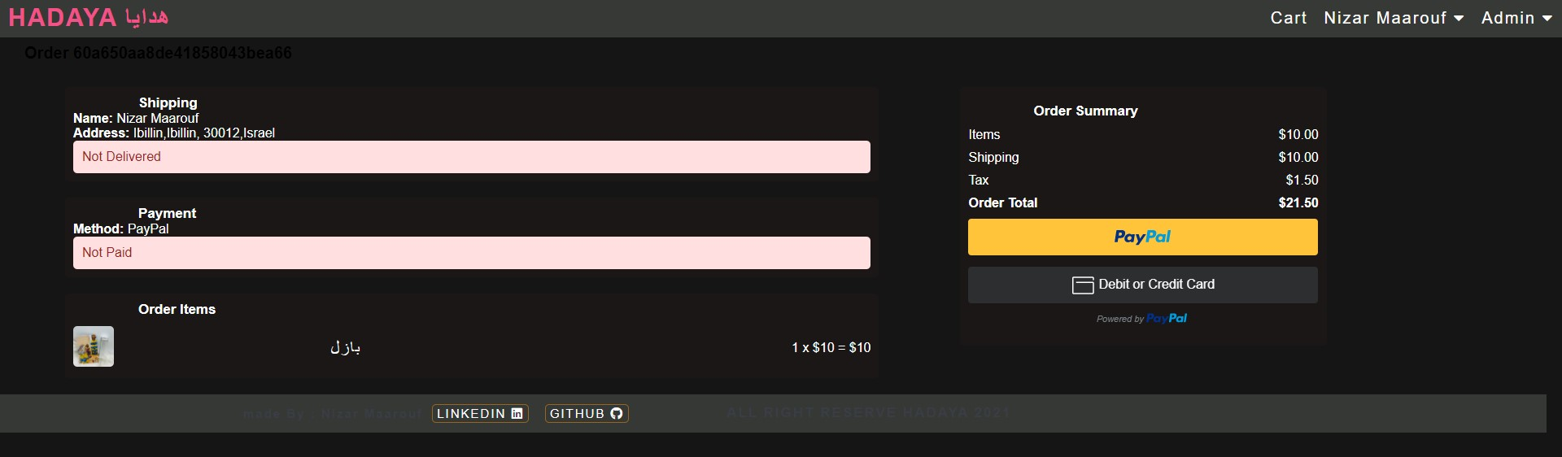

Slide 6
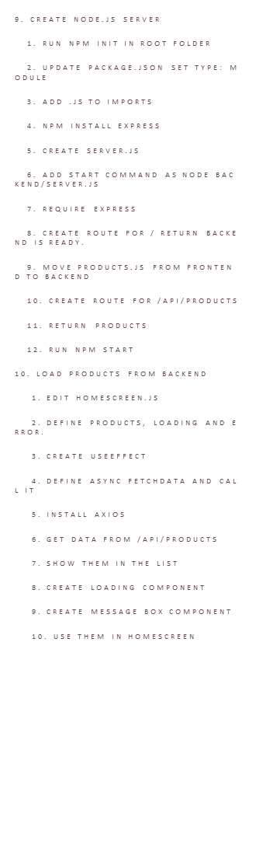
1. Introduction to this course
1. what you will build
2. what you will learn
3. who are audiences
2. Install Tools
1. Code Editor
2. Web Browser
3. VS Code Extension
3. Website Template
1. Create HADAYA folder
2. create template folder
3. create index.html
4. add default HTML code
5. link to style.css
6. create header, main and footer
7. style elements
4. Display Products
1. create products div
2. add product attributes
3. add link, image, name and price
5. Create React App
1. npx create-react-app frontend
2. npm start
3. Remove unused files
4. copy index.html content to App.js
5. copy style.css content to index.css
6. replace class with className
6. Share Code On Github
1. Initialize git repository
2. Commit changes
3. Create github account
4. Create repo on github
5. connect local repo to github repo
6. push changes to github
7. Create Rating and Product Component
1. create components/Rating.js
2. create div.rating
3. style div.rating, span and last span
4. Create Product component
5. Use Rating component
8. Build Product Screen
1. Install react-router-dom
2. Use BrowserRouter and Route for Home Screen
3. Create HomeScreen.js
4. Add product list code there
5. Create ProductScreen.js
6. Add new Route from product details to App.js
7. Create 3 columns for product image, info and action
11. Install ESlint For Code Linting
1. install VSCode eslint extension
2. npm install -D eslint
3. run ./node_modules/.bin/eslint --init
4. Create ./frontend/.env
5. Add SKIP_PREFLIGHT_CHECK=true
12. Add Redux to Home Screen
1. npm install redux react-redux
2. Create store.js
3. initState= {products:[]}
4. reducer = (state, action) => switch LOAD_PRODUCTS: {products: action.payload}
5. export default createStore(reducer, initState)
6. Edit HomeScreen.js
7. shopName = useSelector(state=>state.products)
8. const dispatch = useDispatch()
9. useEffect(()=>dispatch({type: LOAD_PRODUCTS, payload: data})
10. Add store to index.js
13. Add Redux to Product Screen
1. create product details constants, actions and reducers

